Slide 1

Youtube Video Trending Analysis – Predicting Views
Team 10
Harini Kamarthy
Vaishnavi Gunna
Swapna Sonti
Kusuma Kumari Dama
Likhitha Bodepudi

Slide 2

Outline
Motivation
Image to illustrate
Challenges
Technical Flow
Experimental Results
Conclusion
Limitation & Future Enhancement

Slide 3

Motivation
YouTube is the second-largest search engine in the world, with over 2 billion monthly active users, making it a popular platform for content creators to showcase their talent and brands to reach their target audience. With millions of videos uploaded to YouTube every day, it is crucial to identify what makes a video go viral or trend. Understanding the factors that contribute to a video's success can help content creators and marketers optimize their videos to achieve maximum engagement and reach their desired audience.
Predicting the number of views a video will receive can also help content creators to understand the potential impact of their video. This project aims to predict the number of views a video will receive on YouTube by analyzing various features such as likes, dislikes, comments, and other metadata.

Slide 4
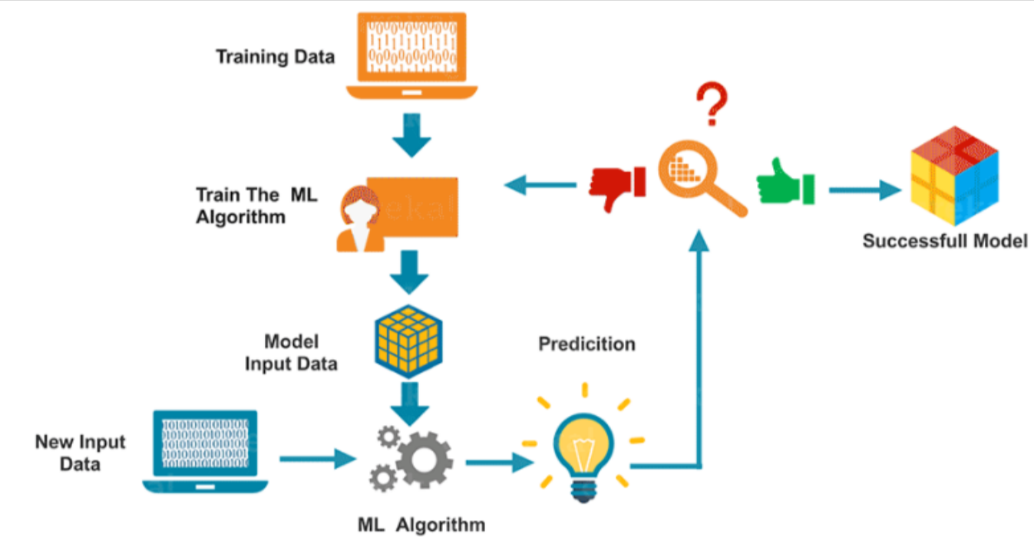
Image to illustrate

Slide 5

Challenges
Challenge of this project is to select the relevant features that contribute to a video's success and develop an accurate predictive model.
Additionally, the dataset used in this project is noisy, and so data cleaning and pre-processing play a crucial step in developing an accurate model.

Slide 6
Technical Flow
Dataset collection and pre-processing - This involves collecting data from related websites and cleaning, formatting, and combining it into a single dataset.
Feature engineering and selection - This involves identifying relevant features that contribute to a video's success on YouTube and selecting and transforming the features to improve the model's accuracy.
Model selection and development - This involves evaluating different machine learning algorithms and selecting the most appropriate algorithm for the project.
Model evaluation and analysis - This involves evaluating the performance of the predictive model using various metrics such as Mean Absolute Error, Mean Squared Error and R2-score. The model's predictions can also be analyzed to identify the factors that contribute to a video's success on YouTube.
Overall, the technical part of the project involves a combination of data collection, data analysis, and machine learning techniques to analyze the YouTube Trending Videos dataset and predict the number of views for a video.

Slide 7
Experimental Results
Gathered the “Trending YouTube Video Statistics” data set from the Kaggle website. Downloaded the “US_category_id.JSON” and “USvideos.CSV” data files.
In the file “Usvideos.csv” Features of the dataset include ‘video_id’, ‘trending_date’, ‘title’, ‘channel_title’, ‘category_id’, ‘publish_time’, ‘tags’, ‘views’, ‘likes’, and ‘dislikes’, as well as ‘comments_disabled’, ‘ratings_disabled’, ‘video_error_or_removed’, and ‘description’.
‘kind’, ‘etag’, ‘id’, ‘snippet/channelId’, ‘snippet/title’, and ‘snippet/assignable’ are all contained in the “US_category_id.json” file.
Combined two datasets and cleaned the data by eliminating undesired characteristics that don't help forecast values.

Slide 8
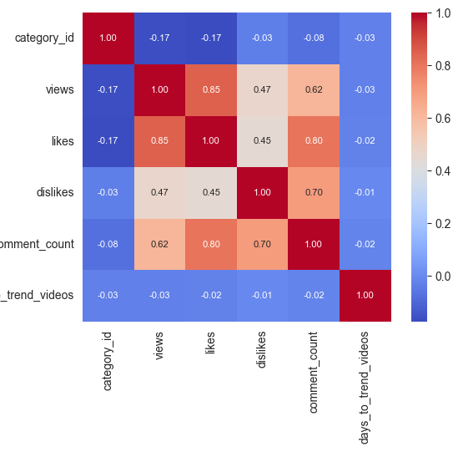
Experimental Results (Continued)
Recognized the relationship between the features that improves the accuracy of "Views" prediction.
Used Pair Plot Graph and Correlation Matrix to find the associated characteristics.
An illustration of a correlation matrix which we got with our dataset.

Slide 9
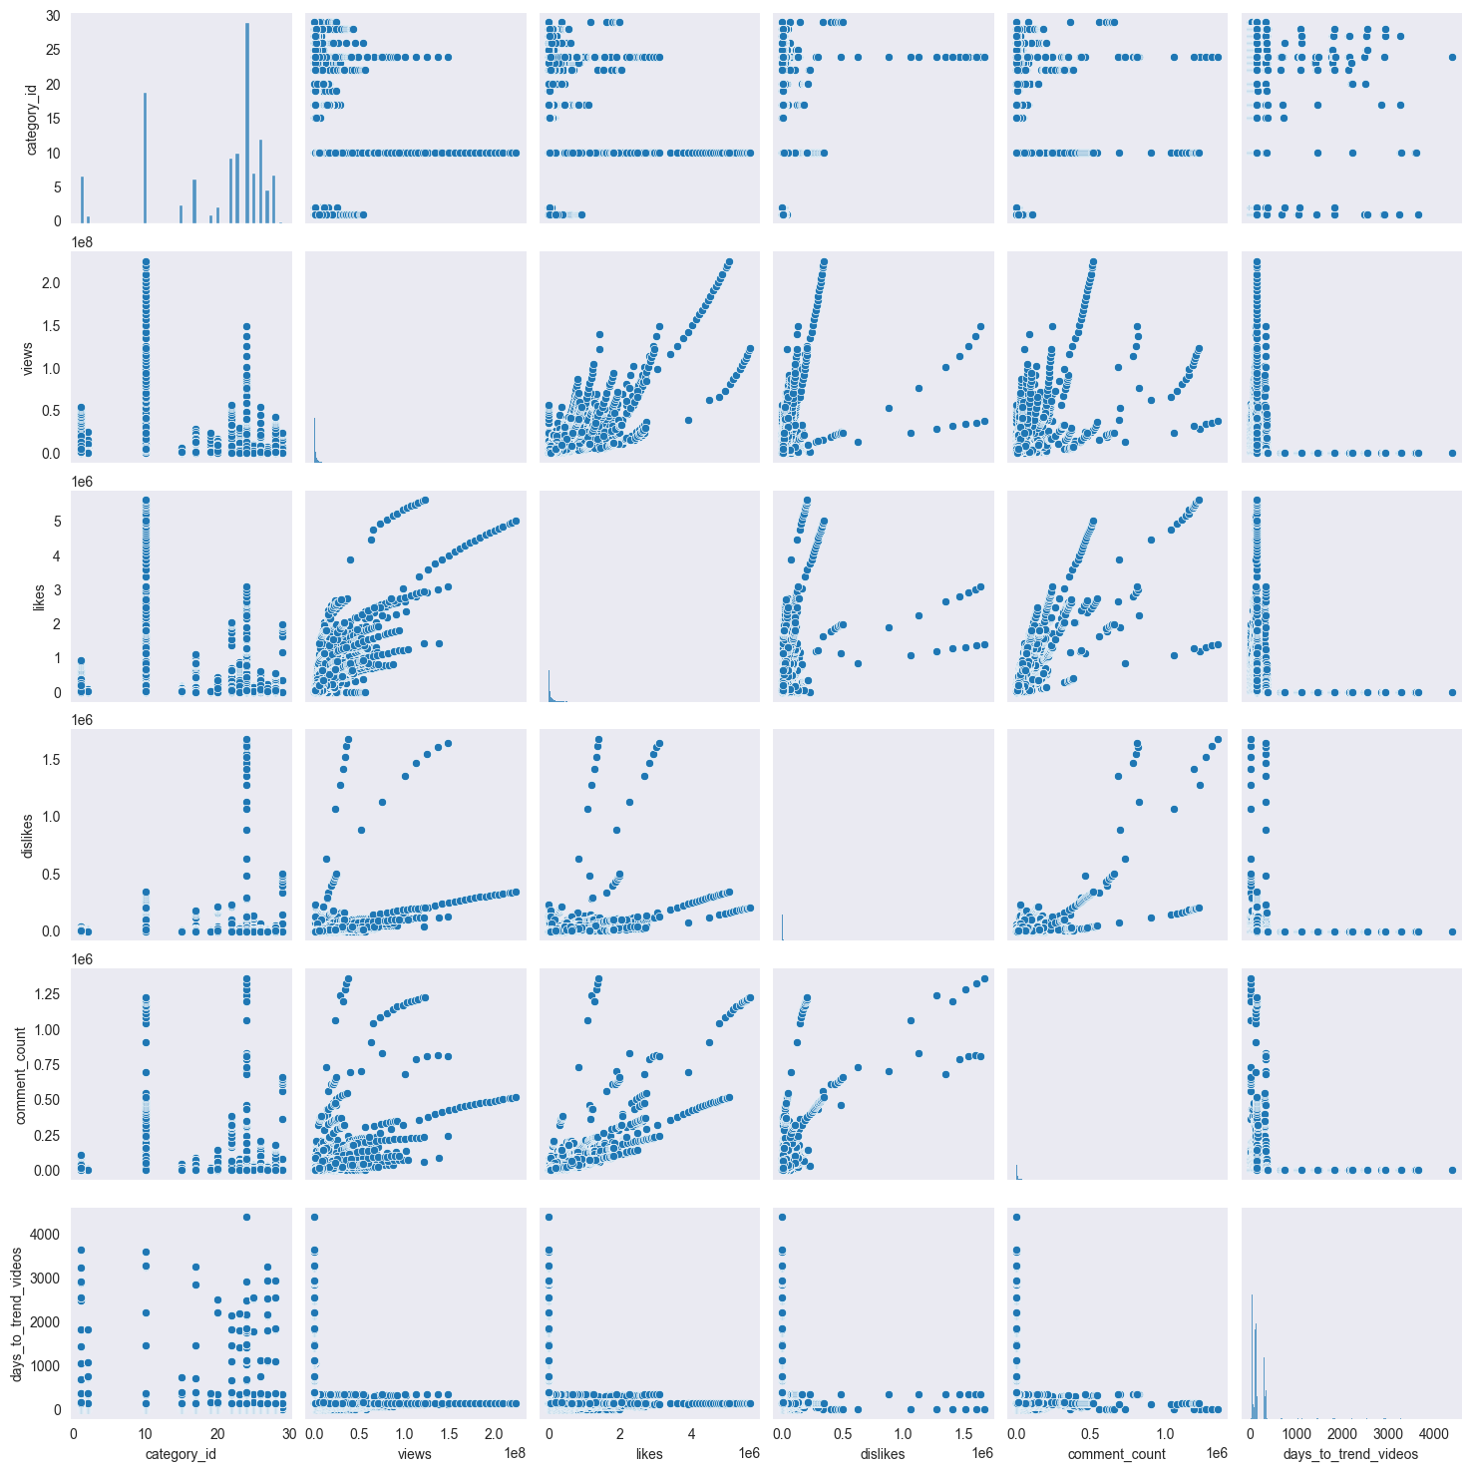
Experimental Results(Continued)
An illustration of a pair plot.
An illustration of a correlation matrix which we got with our dataset.
We discovered a significant relationship between Views and the "likes, dislikes, and comments_count" attributes using these techniques, and we plan to apply the same relationship in models for predictions.

Slide 10
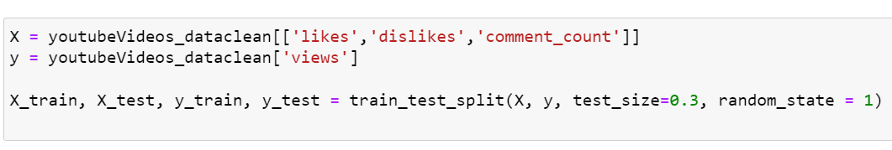
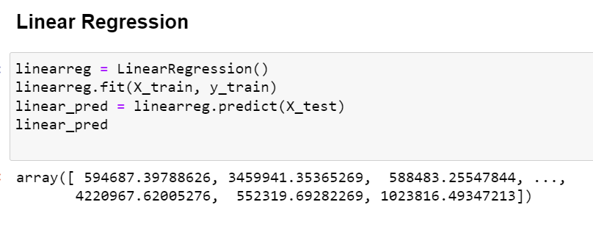
Experimental Results (Continued)
We have employed many Regression models, including Linear Regression, Rigid Regression, Lasso Regression, Random Forest Regression, Decision Tree Regression, Gradient Boosting Regression, MLP Regression, considering our goal variable, "Views," is a continuous variable.
Here we are considering test_size as 0.3 i.e., spliting our dataset into 70-30, 70% data for training the model and 30% data for testing purpose to predict the values
Here is a view of code for one of these model implementation to predict the values, along with it’s output.

Slide 11
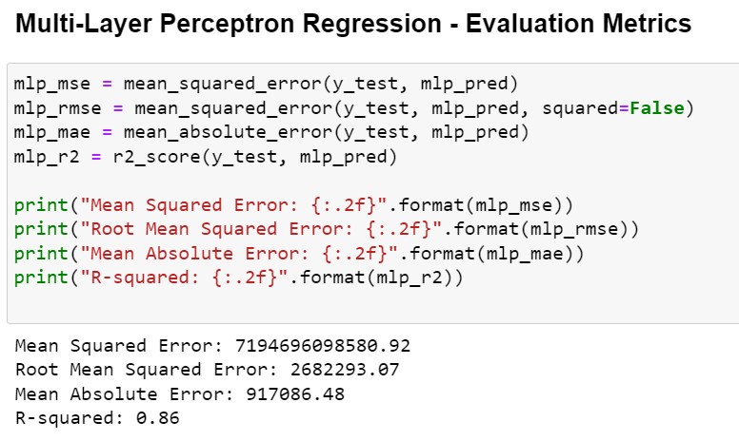
Experimental results (continued)
To determine which approach provides the best model for predicting the optimum values (i.e., the most accurate number for forecasting views of an individual YouTube video), we utilize quality metrics for each model, such as R-Squared Score, Mean Absolute Error, Mean Squared Error and Root Mean Squared Error.
Here is the view of the code for measuring it’s accuracy using these quality metrics for one of the model predicted values, and along with it’s output.

Slide 12
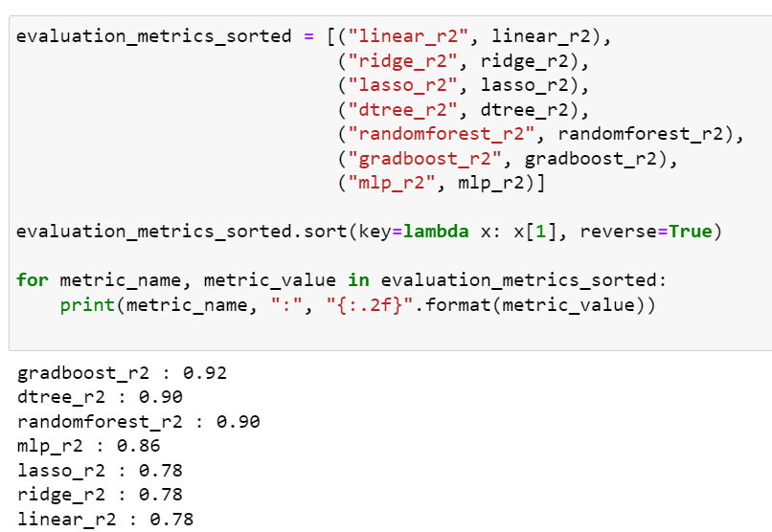
Experimental results (continued)
After finding each quality metric value on each of our 7 predictive models, we can considered R2 Score value to compare their accuracies to find the best suitable model to predict the number of views of a Youtube video.
We see their accuracies here, in decreased order.

Slide 13
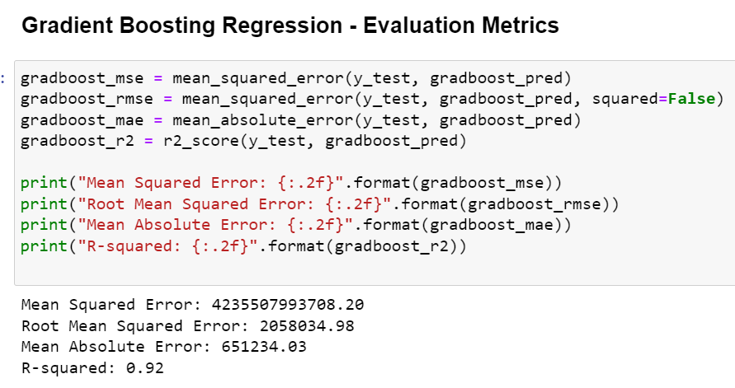
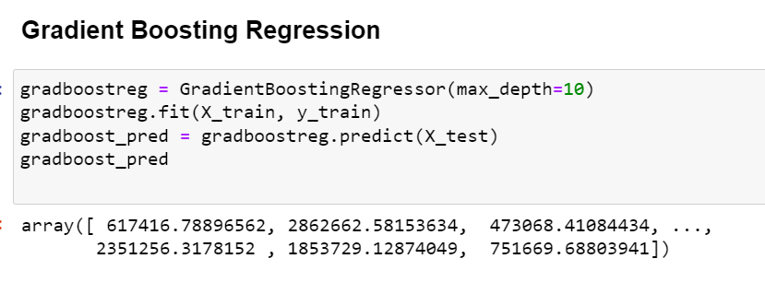
Experimental results (continued)
As we see that Gradient Boosting Model have given the most accuracy percentage of 92%, it’s clear that, “Gradient Boosting Regressor Model” is the best suitable model for our data to predict the most accurate value.
Also, we see that Linear Regression, Ridge Regression and Lasso Regression have the same accuracy value of 78%, and is the least value, which insists that these 3 Regression models are least suitable to predict values.

Slide 14
Conclusion
Based on analysis done in the project, we may make a number of inferences and learn important information about the variables that affect a YouTube video's number of views, including the Category of Video, Engagement, Time-to-trend, Geographic location, and Video Length.
However, in this project, we have used the engagement factor, which is the quantity of likes, dislikes, and comments on a video, since they have a positive correlation with the quantity of views.
Overall, we can create a model that can precisely estimate the number of views for a particular video, based on the relevant factors by utilizing machine learning approaches. By optimizing their video content, content producers and advertisers may increase their chances of success on the platform.

Slide 15
Limitation & Future Enhancement
Future work could involve incorporating additional features into the model, such as video length or category, thubmail, to further improve the accuracy of the predictions.
Also, it can be enhanced to predict the views by using different features, even before uploading the video.

